Slide 1
Orthogonal Functions and Fourier Series
CSE 317
CHAPTER 12
Advanced Engineering Mathematics
D. Zill, W. Wright

Slide 2
Contents
12.1 Orthogonal Functions
12.2 Fourier Series
12.3 Fourier Cosine and Sine Series
12.4 Complex Fourier Series
Ch12_<number>

Slide 3
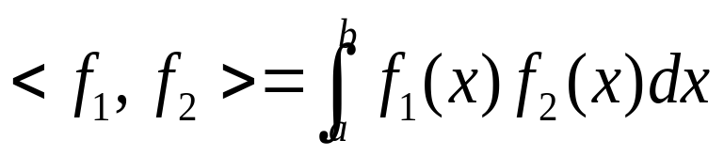
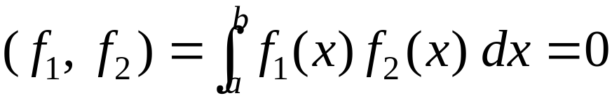
12.1 Orthogonal Functions
DEFINITION 12.1
Inner Product of Function
The inner product of two functions f₁ and f₂ on an
interval [a, b] is the number
DEFINITION 12.2
Orthogonal Function
Two functions f₁ and f₂ are said to be orthogonal on an
interval [a, b] if
Ch12_<number>

Slide 4
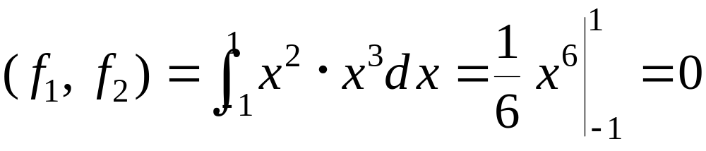
Example
The function f₁(x) = x², f₂(x) = x³ are orthogonal on the interval [−1, 1] since
Ch12_<number>

Slide 5
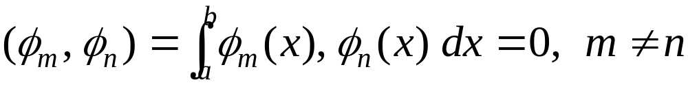
DEFINITION 12.3
Inner Product of Function
A set of real-valued functions {φ₀(x), φ₁(x), φ₂(x), …}
is said to be orthogonal on an interval [a, b] if
(2)
Ch12_<number>

Slide 6
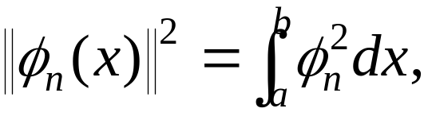
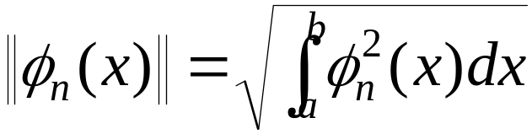
Orthonormal Sets
The expression (u, u) = ||u||² is called the square norm. Thus we can define the square norm of a function as
(3)
If {φ_{n}(x)} is an orthogonal set on [a, b] with the property that ||φ_{n}(x)|| = 1 for all n, then it is called an orthonormal set on [a, b].
Ch12_<number>

Slide 7
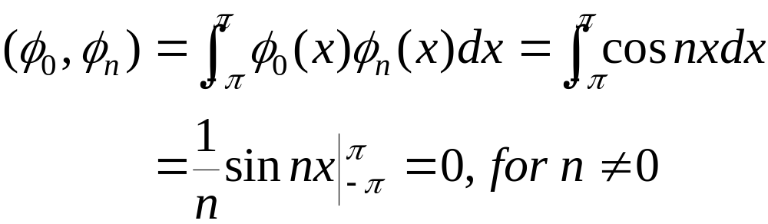
Example 1
Show that the set {1, cos x, cos 2x, …} is orthogonal on [−π, π].
Solution
Let φ₀(x) = 1, φ_{n}(x) = cos nx, we show that
Ch12_<number>

Slide 8
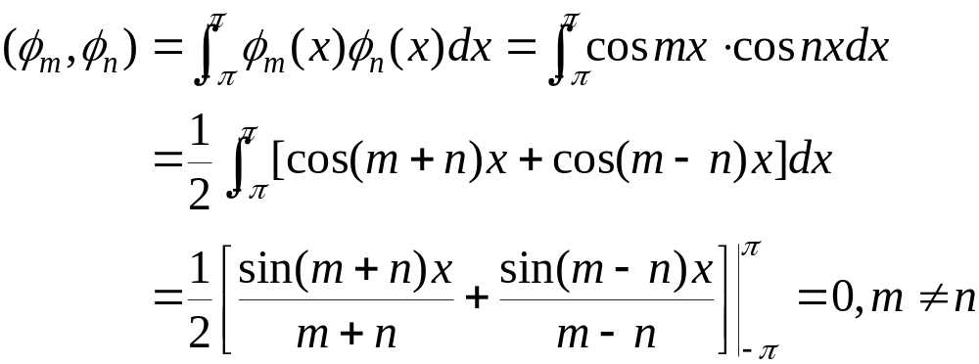
Example 1 (2)
and
Ch12_<number>

Slide 9
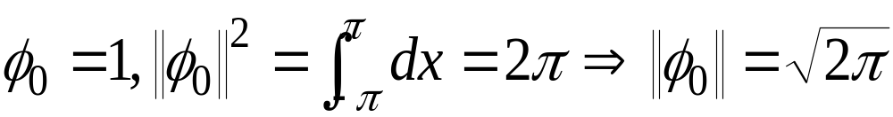
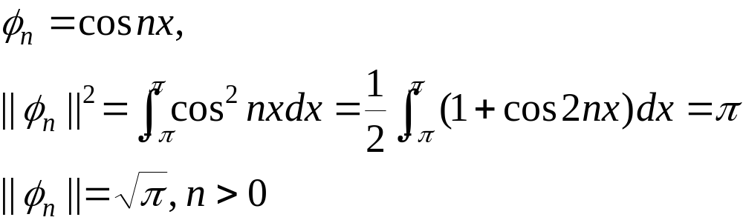
Example 2
Find the norms of each functions in Example 1.
Solution
Ch12_<number>

Slide 10

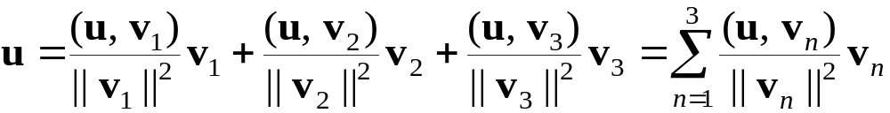
Vector Analogy
Recalling from the vectors in 3-space that
(4)
we have
(5)
Thus we can make an analogy between vectors and functions.
Ch12_<number>

Slide 11

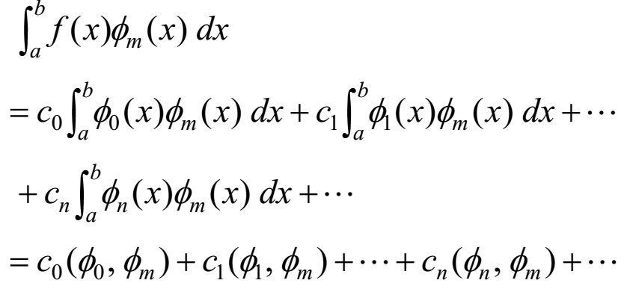
Orthogonal Series Expansion
Suppose {φ_{n}(x)} is an orthogonal set on [a, b]. If f(x) is defined on [a, b], we first write as
(6)
Then
Ch12_<number>

Slide 12
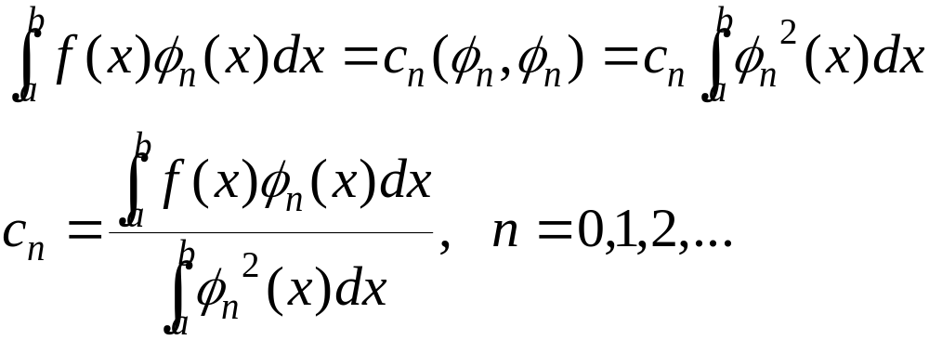
Since {φ_{n}(x)} is an orthogonal set on [a, b], each term on the right-hand side is zero except m = n. In this case we have
Ch12_<number>

Slide 13
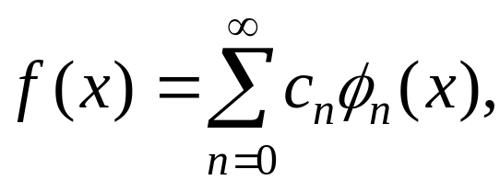
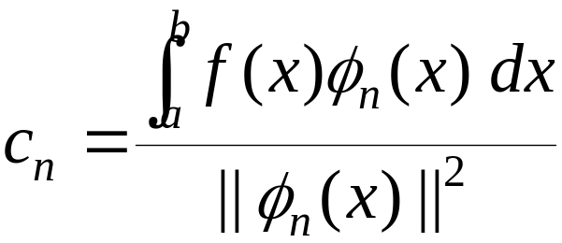
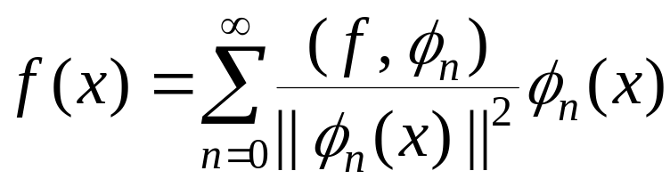
In other words,
(7)
(8)
Then (7) becomes
(9)
Ch12_<number>

Slide 14
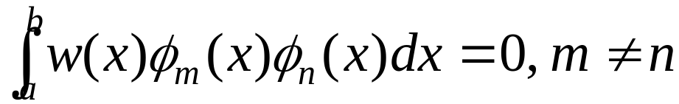
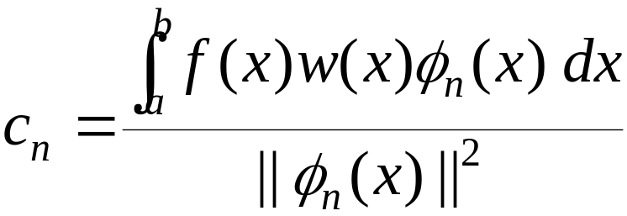
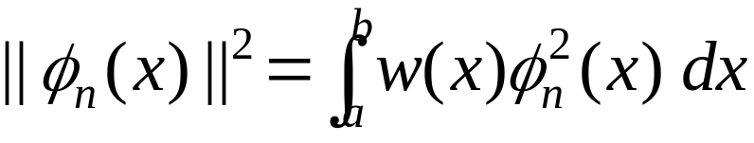
DEFINITION 12.4
A set of real-valued functions {φ₀(x), φ₁(x), φ₂(x), …}
is said to be orthogonal with respect to a weight
function w(x) on [a, b], if
Orthogonal Set/Weight Function
Under the condition of the above definition, we have
(10)
(11)
Ch12_<number>

Slide 15
Complete Sets
An orthogonal set is complete if the only continuous function orthogonal to each member of the set is the zero function.
  If f is orthogonal to every φ_{n} then c_{n} = 0 for all n
Ch12_<number>

Slide 16
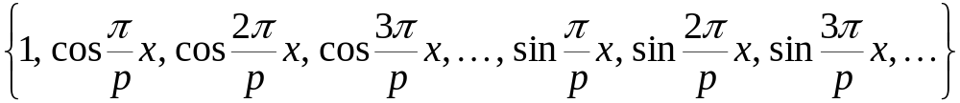
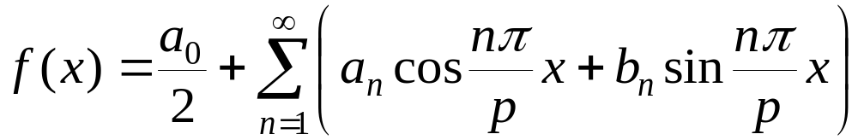
12.2 Fourier Series
Trigonometric Series
We can show that the set
(1)
is orthogonal on [−p, p]. Thus a function f defined on [−p, p] can be written as
(2)
Ch12_<number>

Slide 17
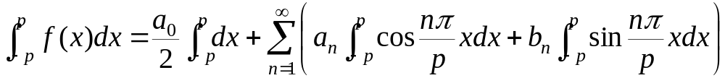
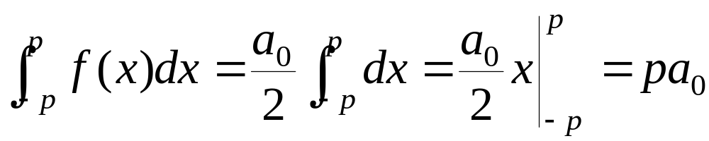
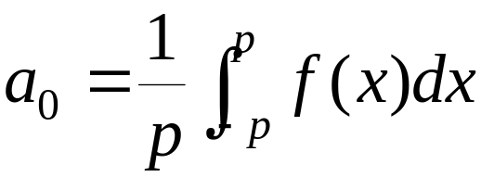
Now we calculate the coefficients.
(3)
Since cos(nπx/p) and sin(nπx/p) are orthogonal to 1 on this interval, then (3) becomes
Thus we have
(4)
Ch12_<number>

Slide 18
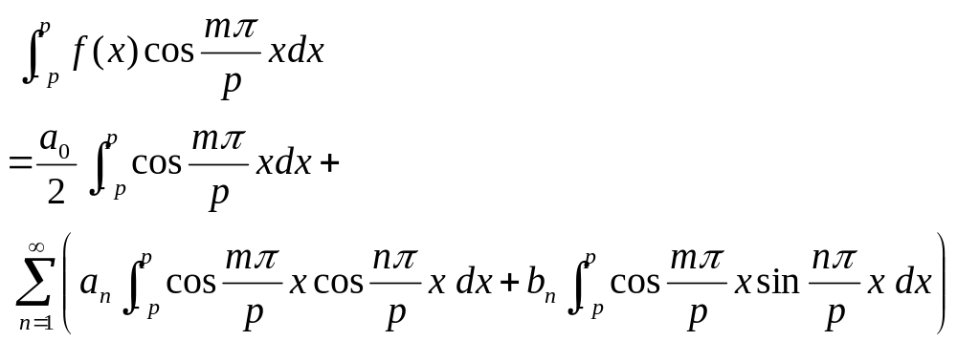
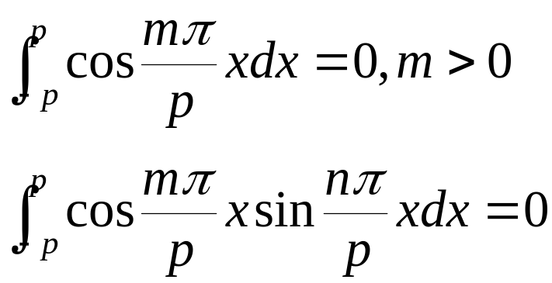
In addition,
(5)
by orthogonality we have
Ch12_<number>

Slide 19
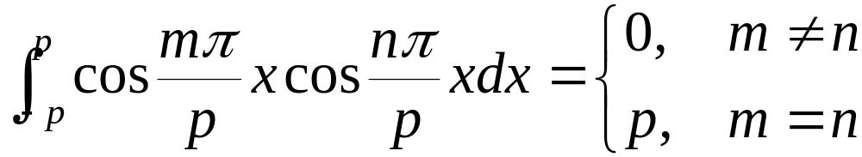
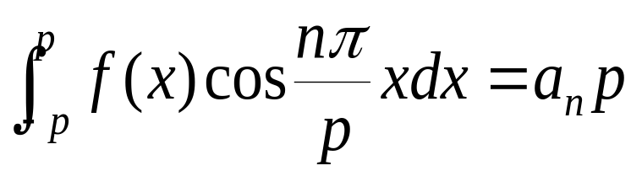
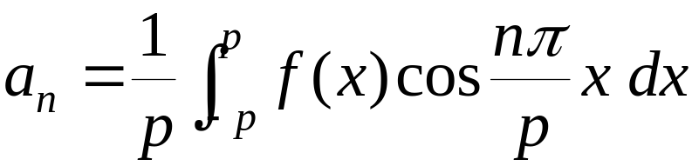
and
Thus (5) reduces to
and so
(6)
Ch12_<number>

Slide 20
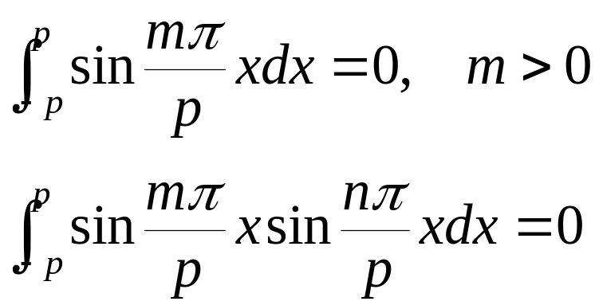
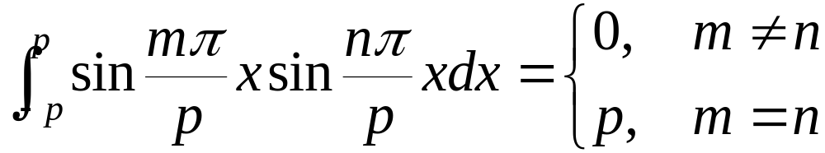
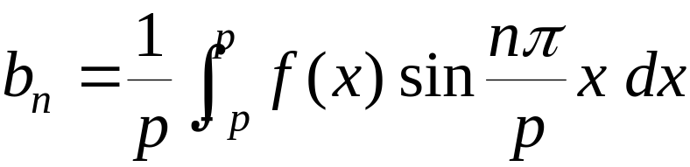
Finally, if we multiply (2) by sin(mπx/p) and use
and
we find that
(7)
Ch12_<number>

Slide 21
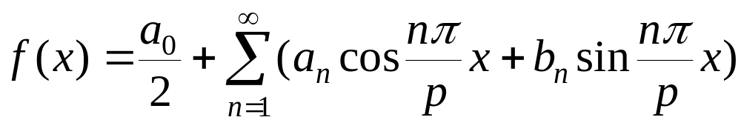
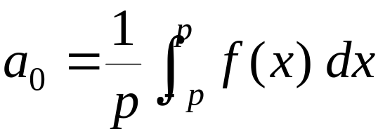
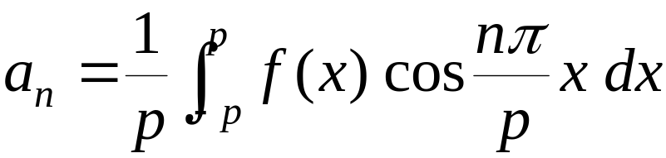
DEFINITION 12.5
Fourier Series
The Fourier series of a function f defined on the
interval (−p, p) is given by
(8)
where
(9)
(10)
(11)
Ch12_<number>

Slide 22
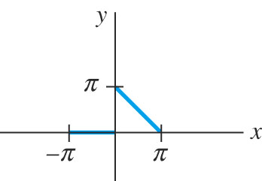
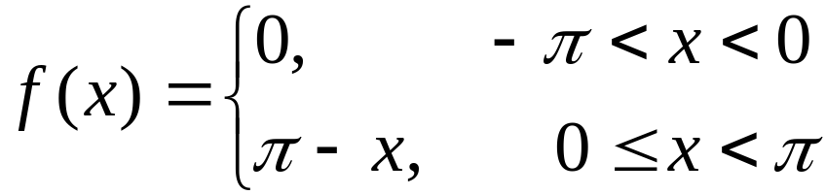
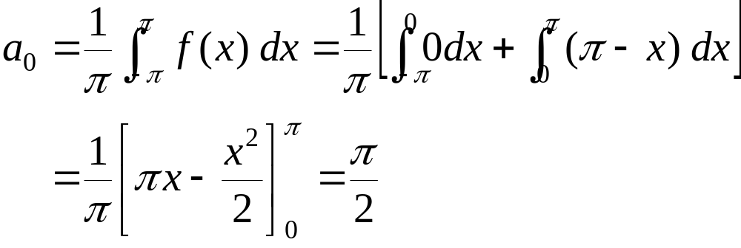
Example 1
Expand
in a Fourier series.
Solution
Here, p = π.
Ch12_<number>

Slide 23
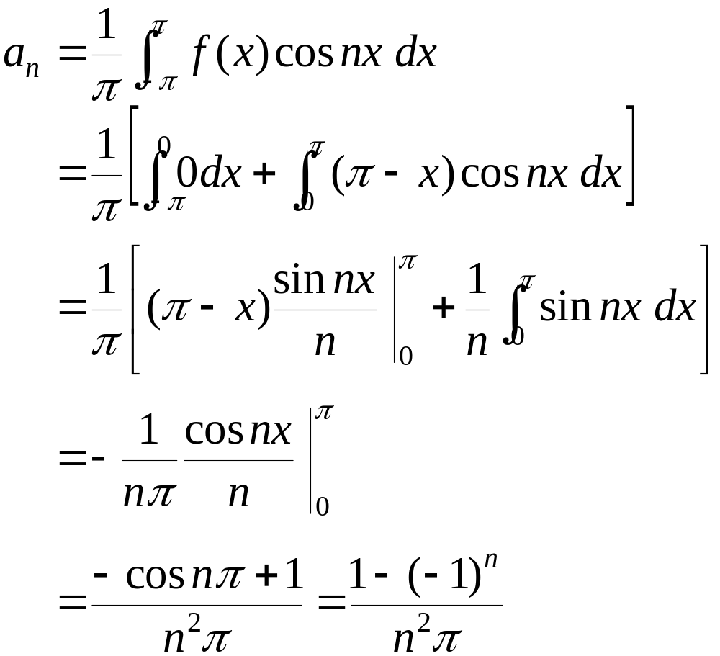
Example 1 (2)
←cos nπ = (-1)^{n}
Ch12_<number>

Slide 24
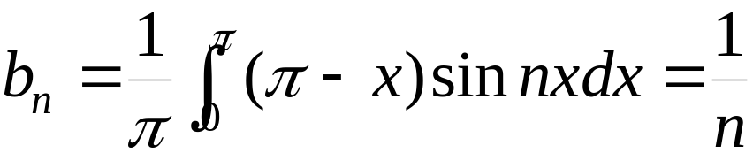
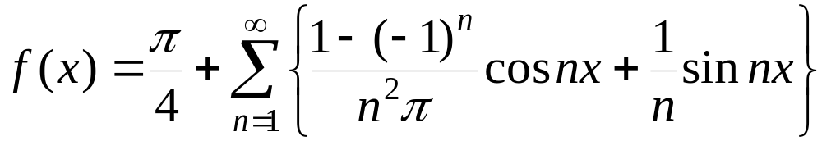
Example 1 (3)
From (11) we have
Therefore
(13)
Ch12_<number>

Slide 25
Fig 12.1
Ch12_<number>

Slide 26
Dirichlet Conditions
Fourier series converges: If f is a real valued function over [-∞, ∞] and if it satisfies the Dirichlet conditions:
  f is bounded over the closed subinterval [a,b]
  f has a finite number of extreme values in [a,b]
  f has only a finite number of (jump) discontinuities in [a,b]
  f is periodic
Ch12_<number>

Slide 27
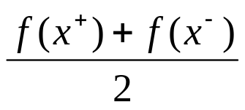
THEOREM 12.1
Let f and f’ be piecewise continuous on the interval (−p, p); that
is, let f and f’ be continuous except at a finite number of points
in the interval and have only finite discontinuities at these points.
Then the Fourier series of f on the interval converge to f(x) at a
point of continuity. At a point of discontinuity, the Fourier
series converges to the average
where f(x⁺) and f(x ⁻) denote the limit of f at x from the right
and from the left, respectively.
Criterion for Convergence
Ch12_<number>

Slide 28
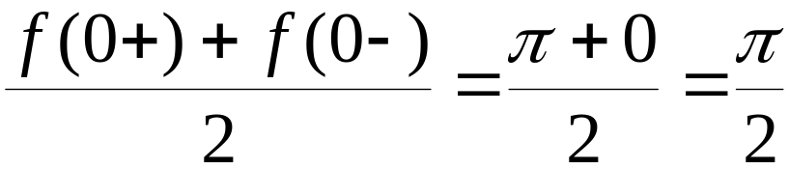
Example 2
Referring to Example 1, function f is continuous on (−π, π) except at x = 0. Thus the series (13) will converge to
at x = 0.
Ch12_<number>

Slide 29
Periodic Extension
A real-valued function f is said to be periodic with period T, if f(x + T) = f(x)
  For example, sin(x+4π)=sin(x), so T = 4π works
The smallest value of T for which f(x+ T)= f (x) holds is called the fundamental period of f.
  For example, the fundamental period of f(x) = sin x is T = 2π
Common period of all the functions in the following set is 2p [Fundamental period of each is 2p/n, n ≥ 1]
Ch12_<number>

Slide 30
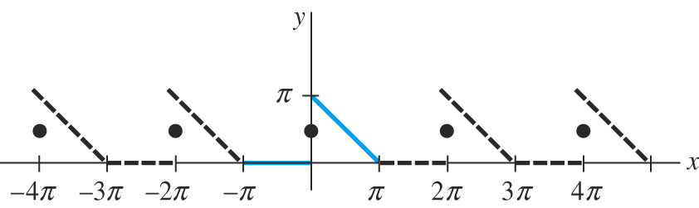
Periodic Extension
a Fourier series (fundamental period = 2p) not only represents the function on the interval (-p, p) but also gives the periodic extension off outside this interval
the periodic extension of the function f in Example 1:
Ch12_<number>

Slide 31
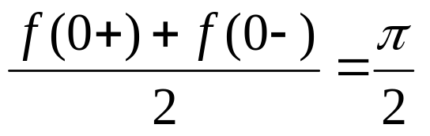
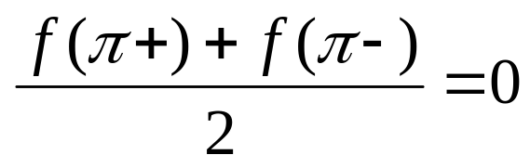
Thus the discontinuity at x = 0, ±2π, ±4π, …will converge to
and at x = ±π, ±3π, … will converge to
Ch12_<number>

Slide 32
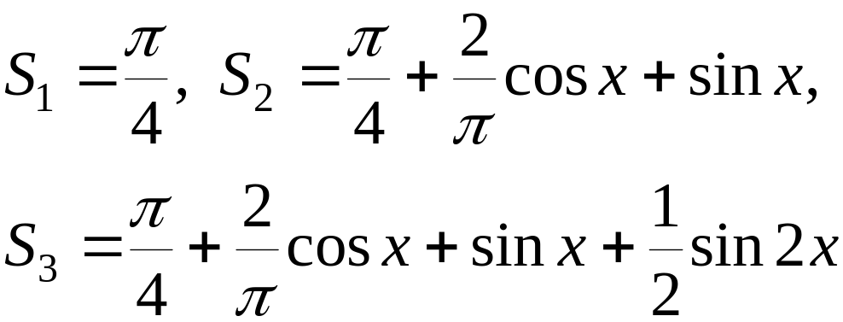
Sequence of Partial Sums
we write the partial sums as
See Fig 12.3.
Ch12_<number>

Slide 33
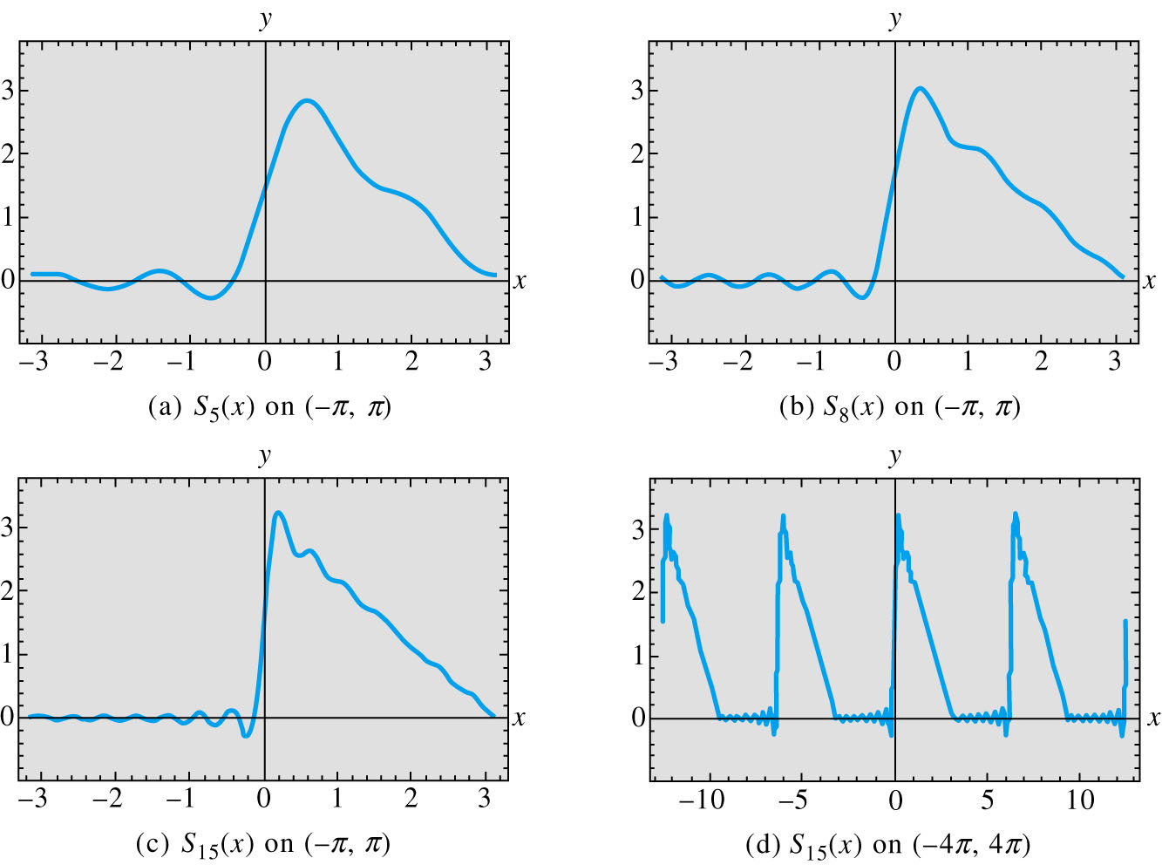
Fig 12.3
Ch12_<number>

Slide 34
12.3 Fourier Cosine and Sine Series
Even and Odd Functions
  even if f(−x) = f(x)
  odd if f(−x) = −f(x)
Ch12_<number>

Slide 35
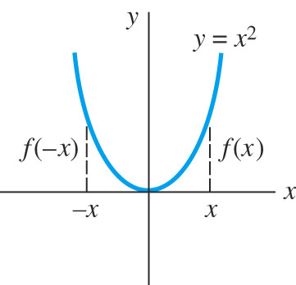
Fig 12.4 Even function
Ch12_<number>

Slide 36
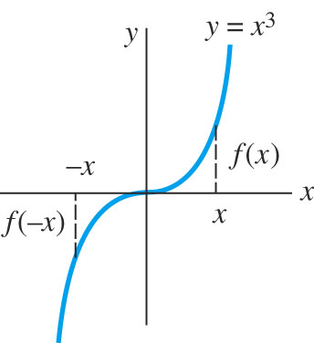
Fig 12.5 Odd function
Ch12_<number>

Slide 37

THEOREM 12.2
(a) The product of two even functions is even.
(b) The product of two odd functions is even.
(c) The product of an even function and an odd function
is odd.
(d) The sum (difference) of two even functions is even.
(e) The sum (difference) of two odd functions is odd.
(f) If f is even then
(g) If f is odd then
Properties of Even/Odd Functions
Ch12_<number>

Slide 38


Cosine and Sine Series
If f is even on (−p, p) then
Similarly, if f is odd on (−p, p) then
Ch12_<number>

Slide 39



DEFINITION 12.6
(i) The Fourier series of an even function f on the
interval (−p, p) is the cosine series
(1)
where
(2)
(3)
Fourier Cosine and Sine Series
Ch12_<number>

Slide 40


(continued)
DEFINITION 12.6
(ii) The Fourier series of an odd function f on the
interval (−p, p) is the sine series
(4)
where
(5)
Fourier Cosine and Sine Series
Ch12_<number>

Slide 41


Example 1
Expand f(x) = x, −2 < x < 2 in a Fourier series.
Solution
Inspection of Fig 12.6, we find it is an odd function on (−2, 2) and p = 2.
Thus
(6)
Fig 12.7 is the periodic extension of the function in Example 1.
Ch12_<number>

Slide 42

Fig 12.6
Ch12_<number>

Slide 43

Fig 12.7
Ch12_<number>

Slide 44



Example 2
The function
shown in Fig 12.8 is odd on (−π, π) with p = π.
From (5),
and so
(7)
Ch12_<number>

Slide 45

Fig 12.8
Ch12_<number>

Slide 46
Gibbs Phenomenon
Fig 12.9 shows the partial sums of (7).
We can see there are pronounced spikes near the discontinuities. This overshooting of S_{N} does not smooth out but remains fairly constant even when N is large. This is so-called Gibbs phenomenon.
Ch12_<number>

Slide 47

Fig 12.9
Ch12_<number>

Slide 48
Half-Range Expansions
If a function f is defined only on 0 < x < L, we can make arbitrary definition of the function on −L < x < 0.
If y = f(x) is defined on 0 < x < L,
  reflect the graph about the y-axis onto −L < x < 0; the function is now even. See Fig 12.10.
  reflect the graph through the origin onto −L < x < 0; the function is now odd. See Fig 12.11.
  define f on −L < x < 0 by f(x) = f(x + L). See Fig 12.12.
Ch12_<number>

Slide 49

Fig 12.10
EVEN
Ch12_<number>

Slide 50

Fig 12.11
ODD
Ch12_<number>

Slide 51

Fig 12.12
Ch12_<number>

Slide 52

Example 3
Expand f(x) = x², 0 < x < L, (a) in a cosine series, (b) in a sine series (c) in a Fourier series.
Solution
The graph is shown in Fig 12.13.
Ch12_<number>

Slide 53


Example 3 (2)
(a)
Then
(8)
Ch12_<number>

Slide 54


Example 3 (3)
(b)
Hence
(9)
Ch12_<number>

Slide 55


Example 3 (4)
(c) With p = L/2, nπ/p = 2nπ/L, we have
Therefore
(10)
The graph of these periodic extension are shown in Fig 12.14.
Ch12_<number>

Slide 56

Fig 12.14
Ch12_<number>

Slide 57
12.4 Complex Fourier Series
Euler’s formula
e^{ix} = cos x + i sin x
e^{-ix} = cos x − i sin x (1)
Ch12_<number>

Slide 58





Complex Fourier Series
From (1), we have
(2)
Using (2) to replace cos(nπx/p) and sin(nπx/p), then
(3)
Ch12_<number>

Slide 59

where c₀ = a₀/2, c_{n} = (a_{n} − ib_{n})/2, c_{-n} = (a_{n} + ib_{n})/2. When the function f is real, c_{n} and c_{-n} are complex conjugates.
We have
(4)
Ch12_<number>

Slide 60

(5)
Ch12_<number>

Slide 61

(6)
Ch12_<number>

Slide 62


DEFINITION 12.7
The Complex Fourier Series of function f defined on
an interval (−p, p)is given by
(7)
where
(8)
Complex Fourier Series
Ch12_<number>

Slide 63

If f satisfies the hypotheses of Theorem 12.1, a complex Fourier series converges to f(x) at a point of continuity and to the average
at a point of discontinuity.
Ch12_<number>

Slide 64

Example 1
Expand f(x) = e^{-x}, −π < x <π, in a complex Fourier series.
Solution
with p = π, (8) gives
Ch12_<number>

Slide 65


Example 1 (2)
Using Euler’s formula
Hence
(9)
Ch12_<number>

Slide 66

Example 1 (3)
The complex Fourier series is then
(10)
The series (10) converges to the 2π-periodic extension of f.
Ch12_<number>

Slide 67


Fundamental Frequency
The fundamental period is T = 2p and then p = T/2.
The Fourier series becomes
or, (11)
where ω₀ = ω = 2π/T is called the fundamental angular frequency.
Ch12_<number>

Slide 68
Frequency Spectrum
If f is periodic and has fundamental period T, the plot of the points (nω, |c_{n}|) is called the frequency spectrum of f.
Ch12_<number>

Slide 69

Example 2
In Example 1, ω = 1, so that nω takes on the values 0, ±1, ±2, …
Using , we see from (9) that
See Fig 12.17.
Ch12_<number>

Slide 70

Fig 12.17
Ch12_<number>

Slide 71


Example 3
Find the spectrum of the wave shown in Fig12.18. The wave is the periodic extension of the function f:
Ch12_<number>

Slide 72

Example 3 (2)
Solution
Here T = 1 = 2p so p = ½. Since f is 0 on (−½, −¼) and (¼, ½), (8) becomes
Ch12_<number>

Slide 73

Example 3 (3)
It is easy to check that
Fig 12.19 shows the frequency spectrum of f.
Ch12_<number>

Slide 74

Fig 12.19
Ch12_<number>

